Slide 1

Xinjie Lan & Liuyi Chai Presentation
--- Story Read Software Development with NAO Robot
Notes:
NOTE:
To change the image on this slide, select the picture and delete it. Then click the Pictures icon in the placeholder to insert your own image.

Slide 2
Background
NAO Robot
Robot in Early Childhood Education

Slide 3
System Architecture
Wordpress
Front-End Languages:
PHP
CSS
Tableau
Independent Learning

Slide 4
Personal Input
Diversity
Problem solving skills

Slide 5
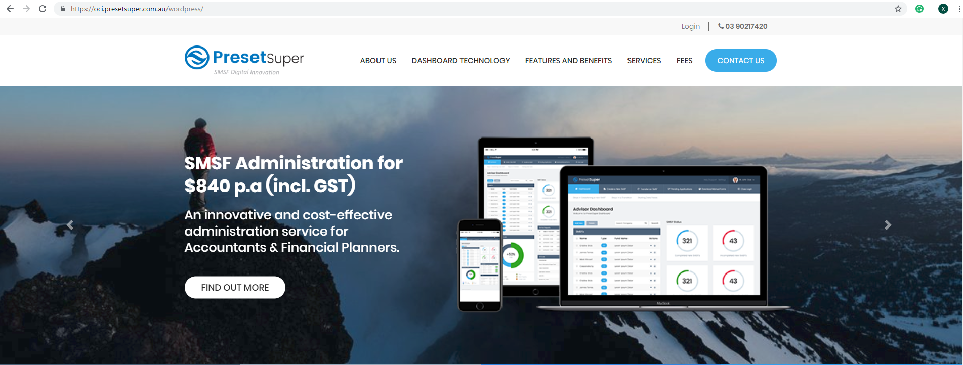

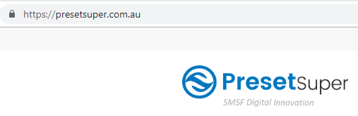
Task Completed--- Preset Super Web on Oracle Cloud Infrasturcture

Slide 6
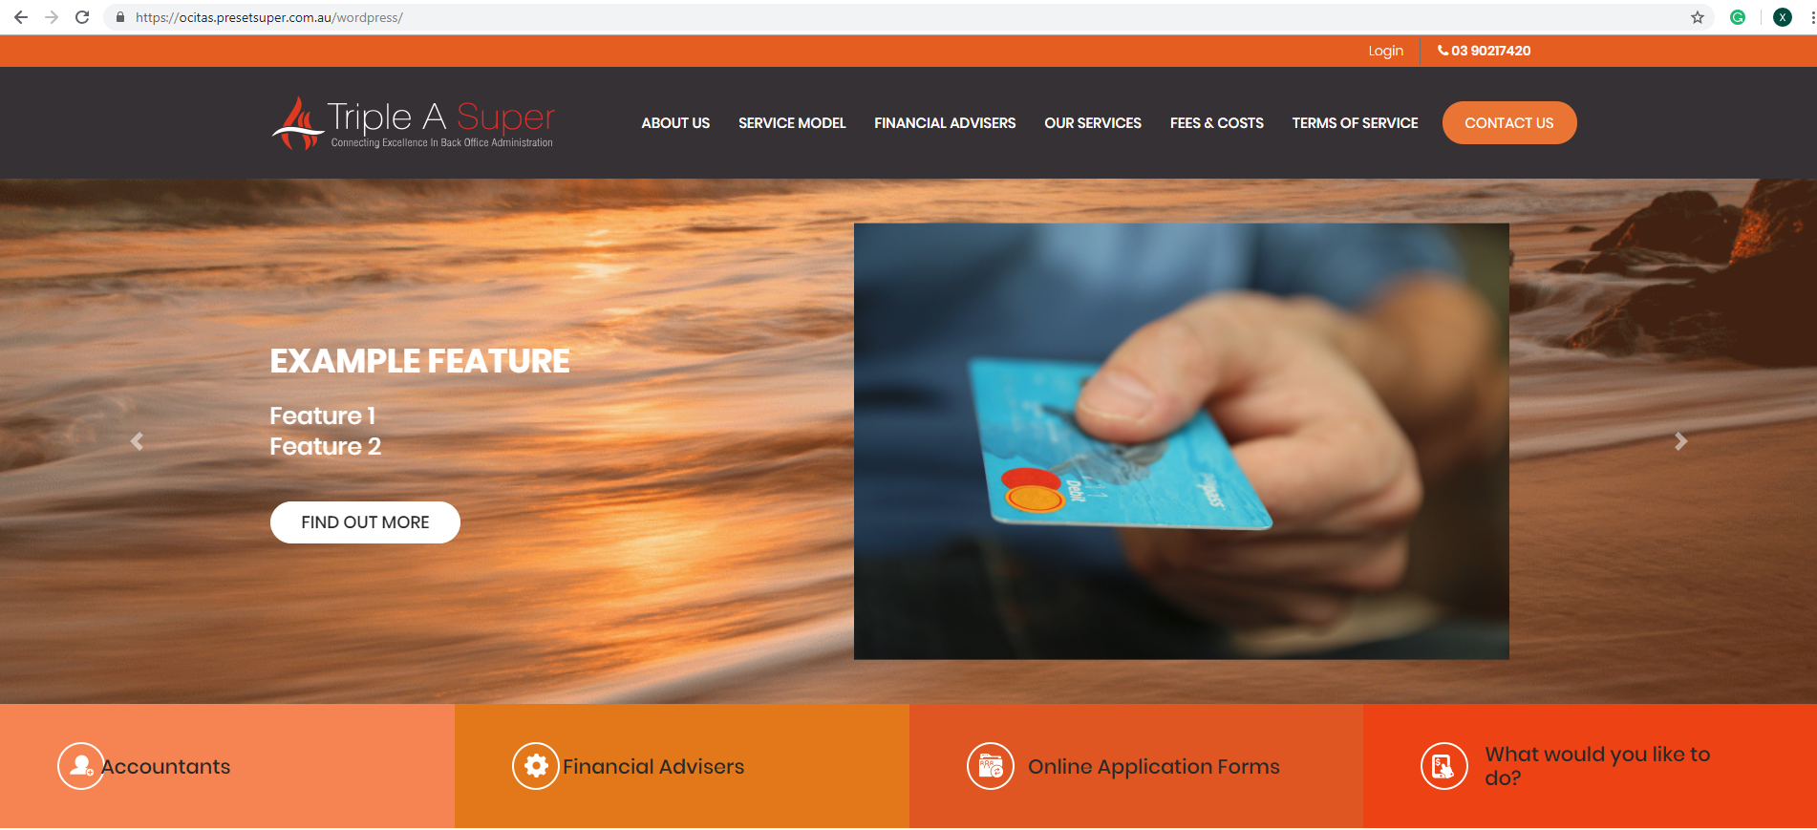
Task Completed--- New Triple A Super Web Prototype

Slide 7
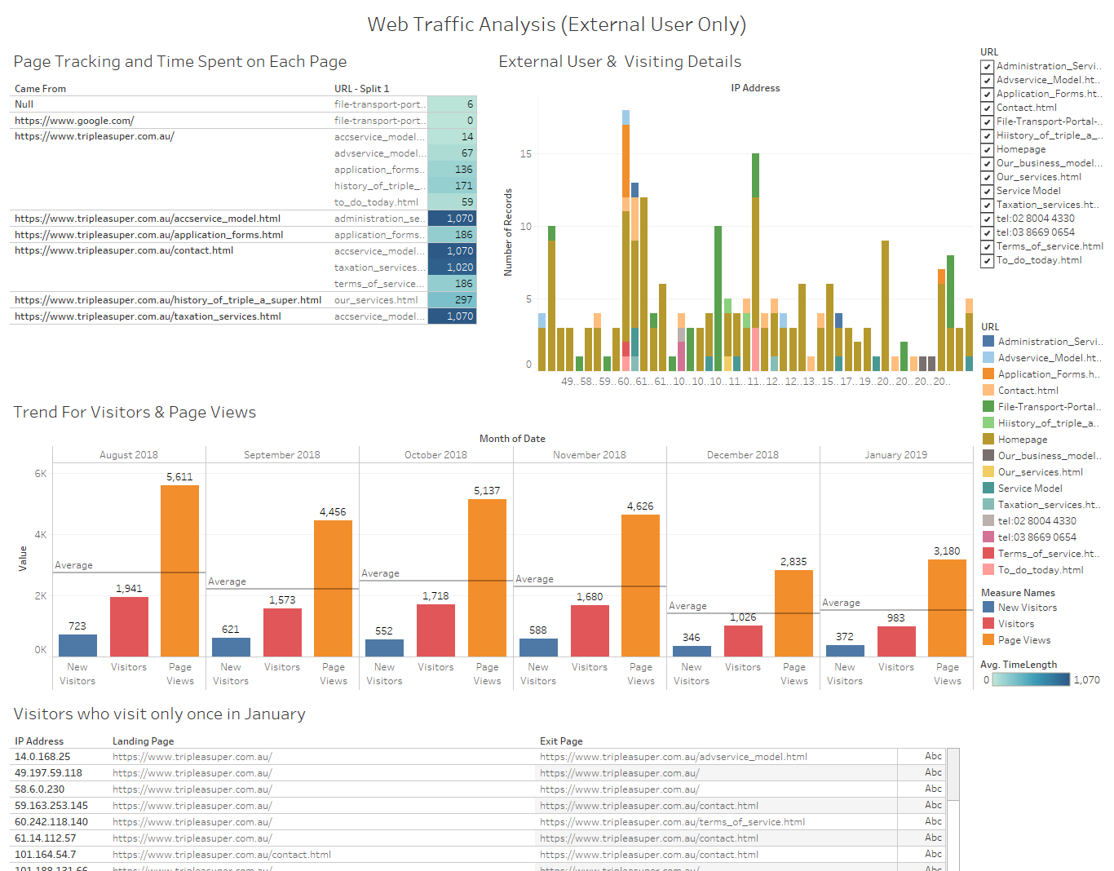
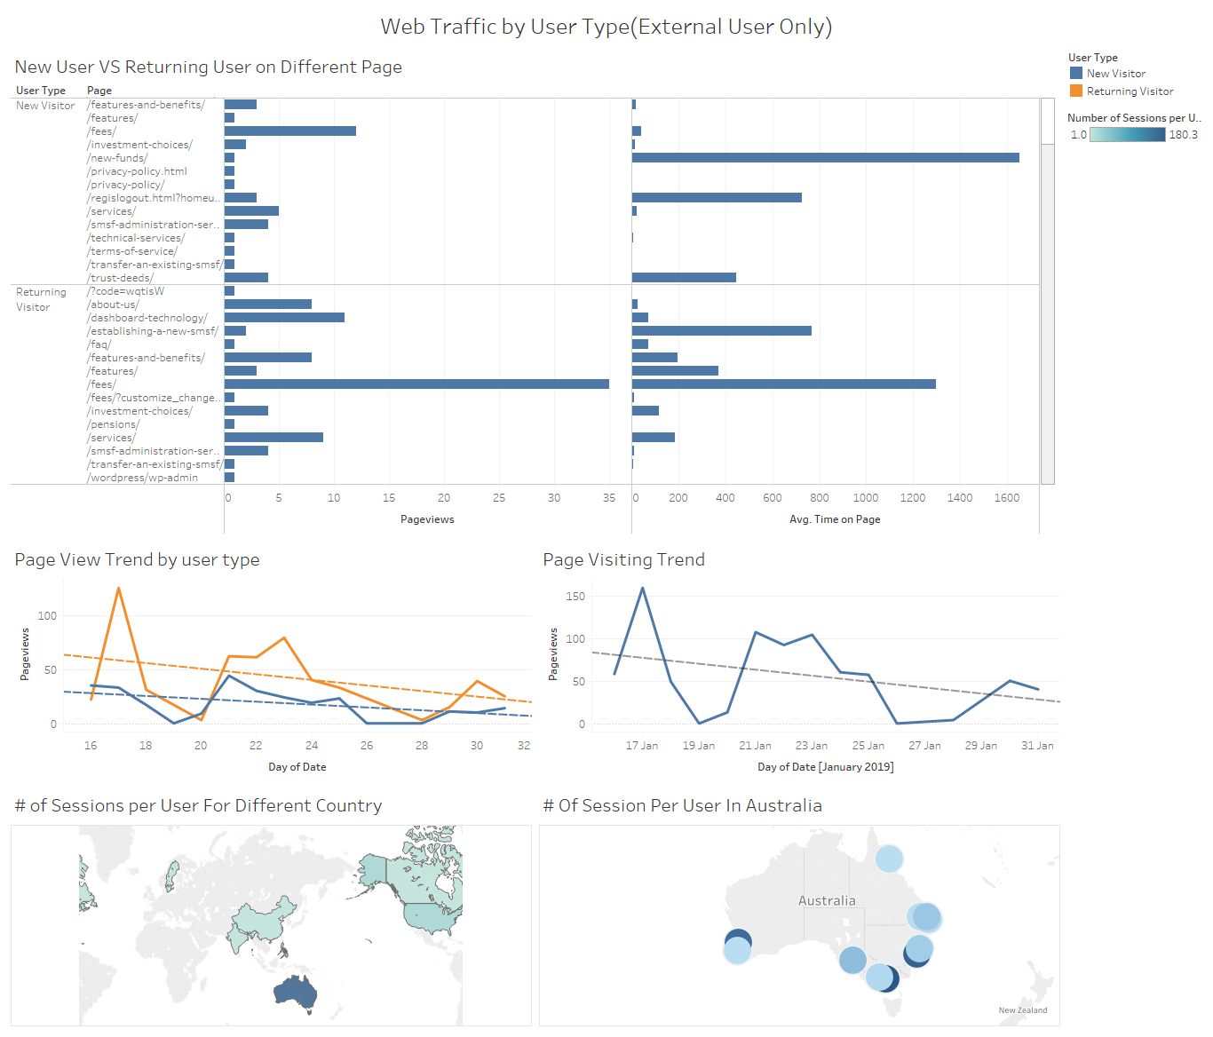
Task Completed--- Web Analytics

Slide 8
Values for Company
Economic value
Reduced time costs for web maintenance
Reduced financial costs for building new web
Increase chance of purchasing by providing more attractive web
Insights on potential market by providing web analysis

Slide 9
What have I learnt
Teamwork
ACS Code of Professional Conduct
--- Competence, Honest, etc
Communication Skills

Slide 10
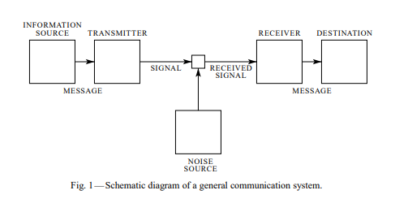
Communication Media
Shannon-Weaver Communication Model
Email/Oral
Reference: A Mathematical Theory of Communication By C. E. SHANNON

Slide 11
Importance of learning the professional skills
Competitive when hunting for jobs
Qualified IT professional

Slide 12
Thank you!

